Slide 1
Calendar App
Team 5
Alex Lundin, Anhquan Nguyen, Brian Bell, Reed CUmmings

Slide 2
GitHub Demo
https://github.com/reedpcummings/3354-team5
Commits
Code Frequency
Meeting Template

Slide 3
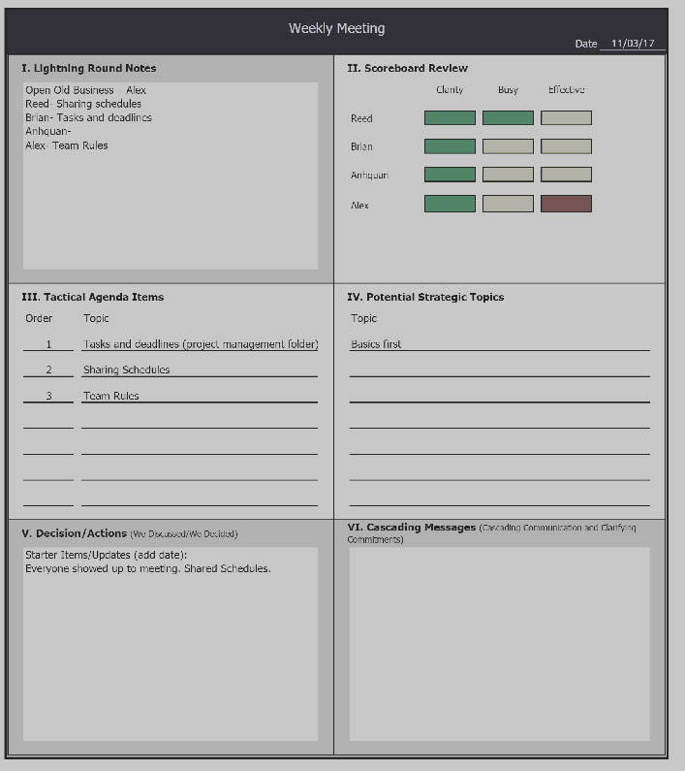
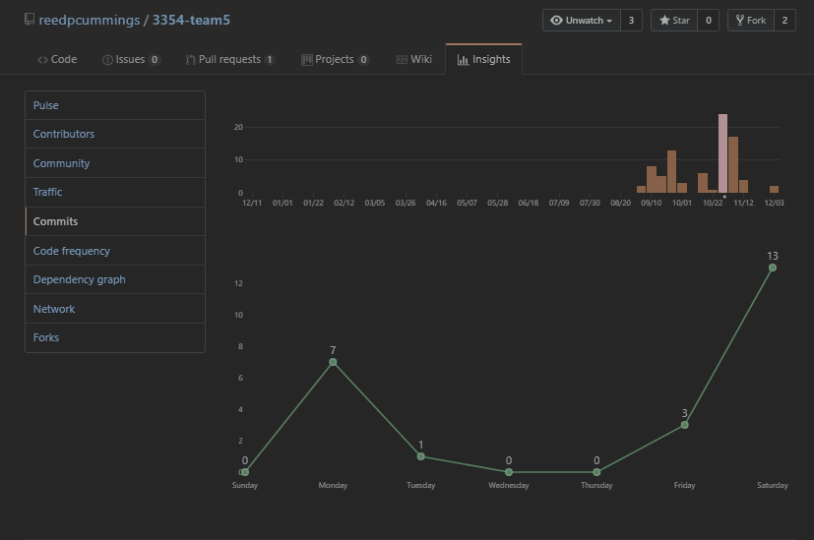
GitHub Demo
SCRUM effectiveness
Most commits week of meetings

Slide 4
Team Organization
Team meetings
SCRUM
Online
Offline
GroupMe
Outlook
Task distribution
Started with the original spec
Delegate during team meeting

Slide 5
Coding Style
No meaningless variable or method names
ex) calling a variable x
No generally named methods
ex) public void do()
Mostly used full words instead of abbreviations
DB is one exception because that is a field wide abbreviation
Proper naming techniques
ex) addEvent

Slide 6
Comments
Generally use block comments with scattered in-line comments
Natural Language in comments so they’re easy to understand
No meaningless comments

Slide 7
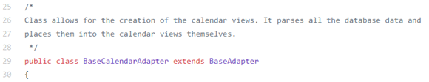
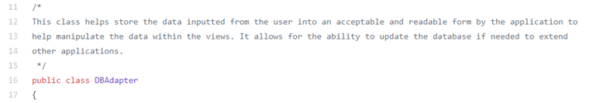
BaseCalendarAdapter
DBAdapter

Slide 8
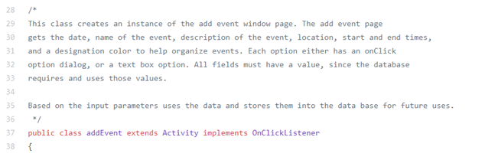
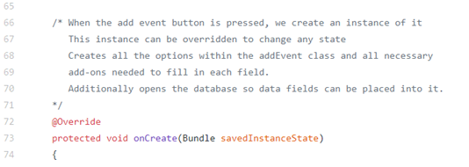
addEvent
onCreate method

Slide 9
Design Pattern
Model-View-Controller Architecture
Good for heavy GUI applications such as a calendar
Good for multiple perspectives
Ex) Daily View, Weekly View, Monthly View
Allows change to the design with minimal impact on the functionality

Slide 10


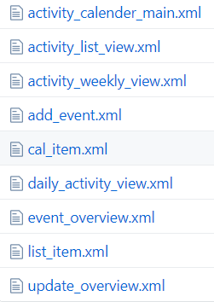
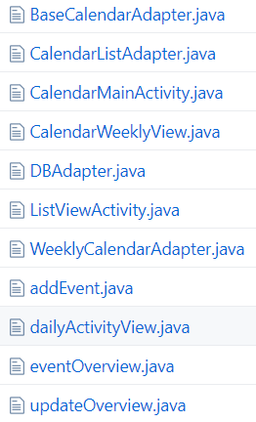

Slide 11
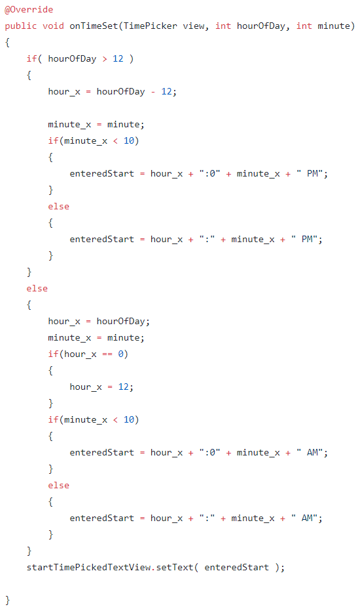
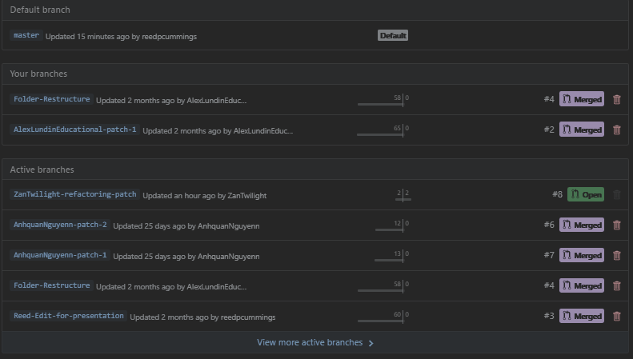
Pre Refactoring

Slide 12
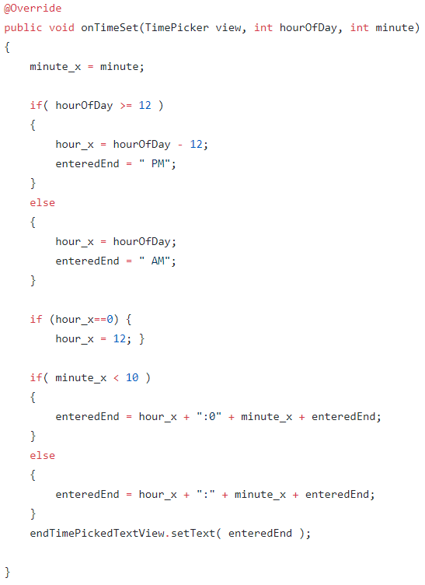
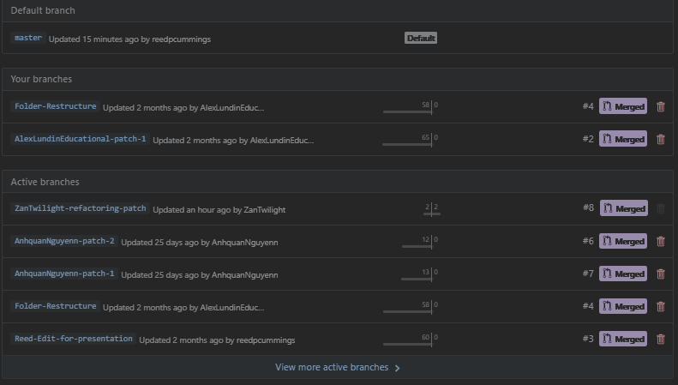
Post Refactoring

Slide 13
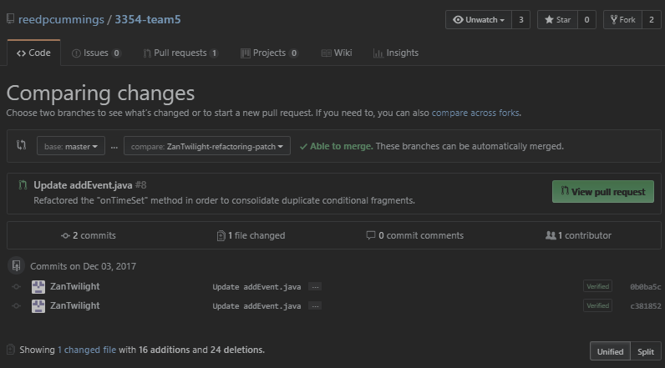
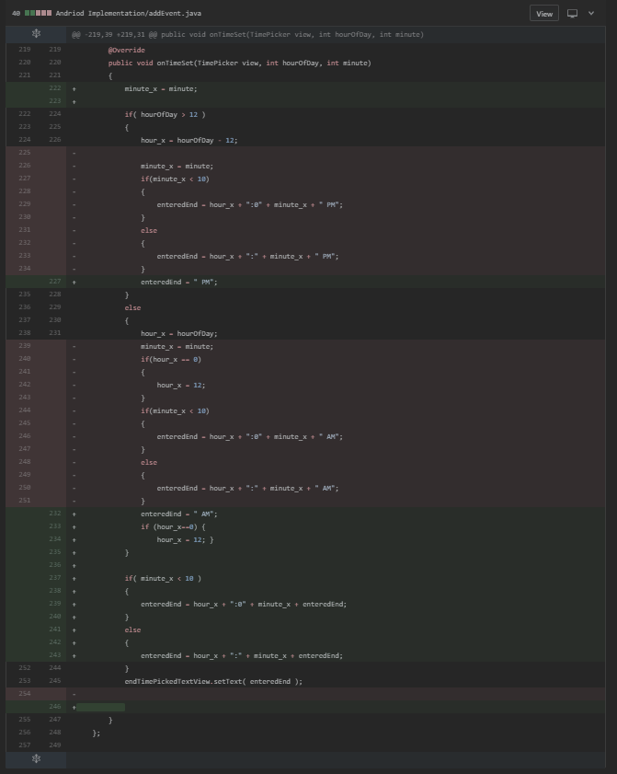
Refactoring

Slide 14
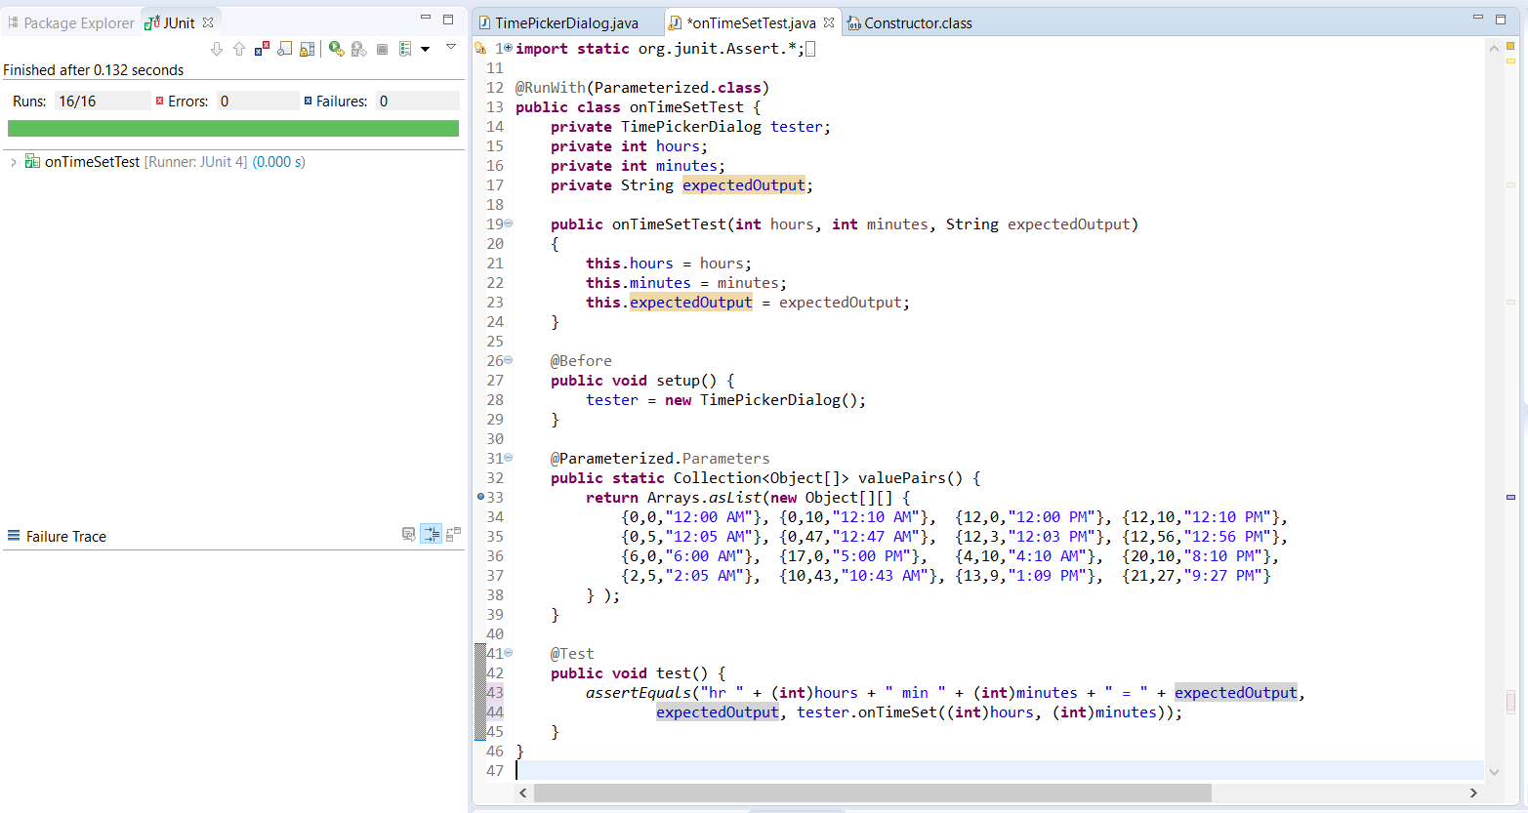
Testing

